Slide 1
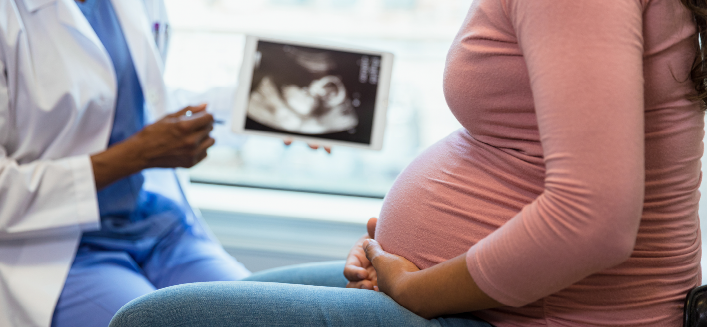

FETAL HEALTH RISK PREDICTION AND PATIENT CLUSTERING FOR PERSONALIZED MATERNAL CARE
PRESENTED BY
Devadarshini Pazhanivel Thenmozhi
Sharon Jennifer Justin Devaraj
Group: 37
Khoury College of Computer Sciences
Northeastern University, Boston, USA

Slide 2
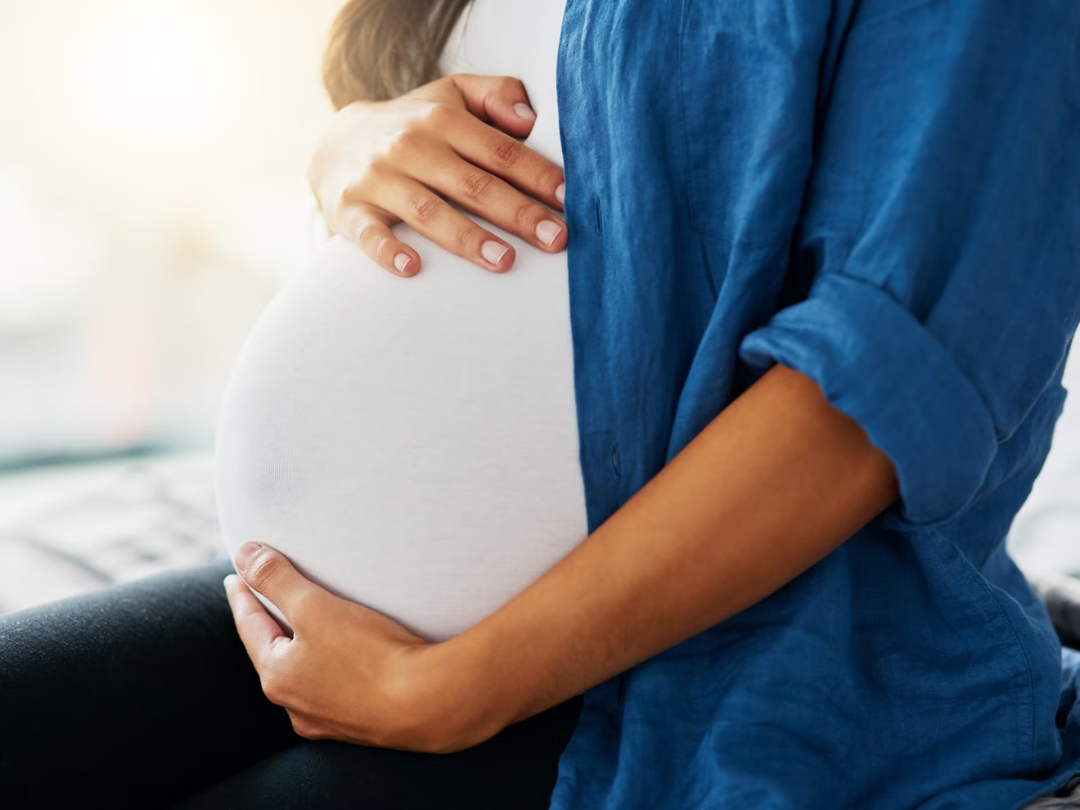
INTRODUCTION
Fetal health issues are a major cause of infant and maternal mortality, especially in developing regions.
Conditions like fetal distress and hypoxia often remain undetected until critical stages.
CTG (Cardiotocography) is widely used to monitor fetal well-being, but manual interpretation is often subjective and inconsistent.
Machine Learning can provide an objective, scalable way to predict fetal risk and support early intervention.
This project builds an interpretable regression-based model to predict fetal distress levels on a continuous scale, improving decision-making in prenatal care.

Slide 3

PROBLEM STATEMENT
Fetal distress can lead to serious problems during pregnancy and delivery.
Doctors use CTG (cardiotocography) to monitor fetal heart rate and contractions.
But reading CTG is often manual and subjective, which can cause mistakes or delays.
There’s no standard tool to give an accurate, continuous risk score for fetal health.
A reliable, automated system is needed to help doctors make better decisions on time.

Slide 4
OBJECTIVE
Build a model to predict fetal health risk scores from CTG data
Use different machine learning models: Ridge, Random Forest, XGBoost
Understand predictions using SHAP for feature importance.
Group patients into Low, Moderate, and High risk using Kmeans and Hierarchical clustering.
Check how well the models work using evaluation metrics.

Slide 5
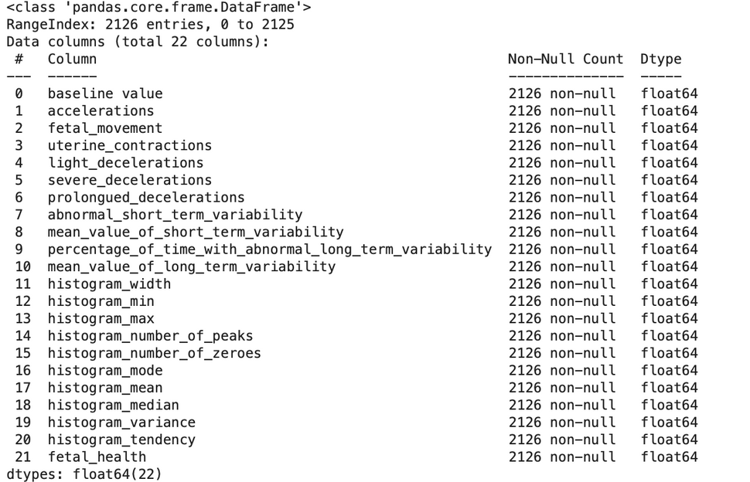
DATASET OVERVIEW
Dataset: CTG-based fetal health data from Kaggle.
Dataset consists of 2126 entries of various attributes of fetal health like accelerations, fetal movement, uterine contractions etc.
Features: 21 numerical features from cardiotocograms
The dataset has a target variable 'fetal_health' with three categories: Normal (1.00), Suspect (2.00), and Pathological (3.00) fetal health.

Slide 6

METHODOLOGY
1
2
3
4
5
6
Dataset consisting of information on fetal movement, uterine contractions and other medical information is taken
Data Preprocessing and Feature Engineering
Perform and evaluate clustering for risk grouping.
Risk Score Engineering
Train and evauate the regression models.
Predict the risk scores.

Slide 7
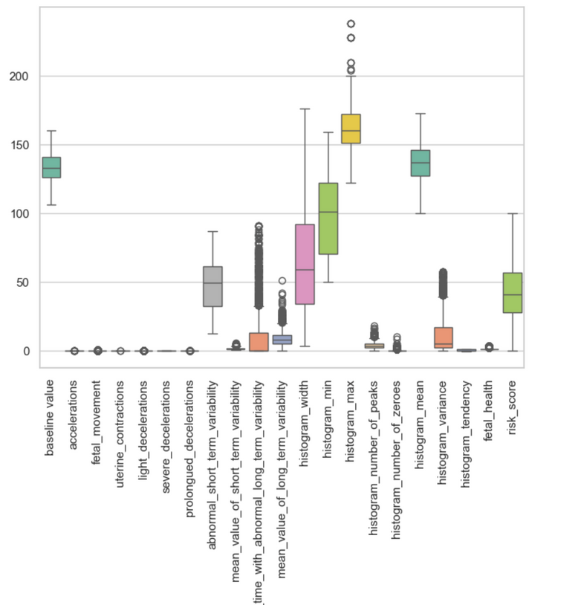

PREPROCESSING
Removed highly correlated features (e.g., histogram_mode, histogram_median)
Handled outliers using the IQR method
Standardized all features using StandardScaler
Ensured better model generalization and convergence
Fig : Outliers in the dataset

Slide 8
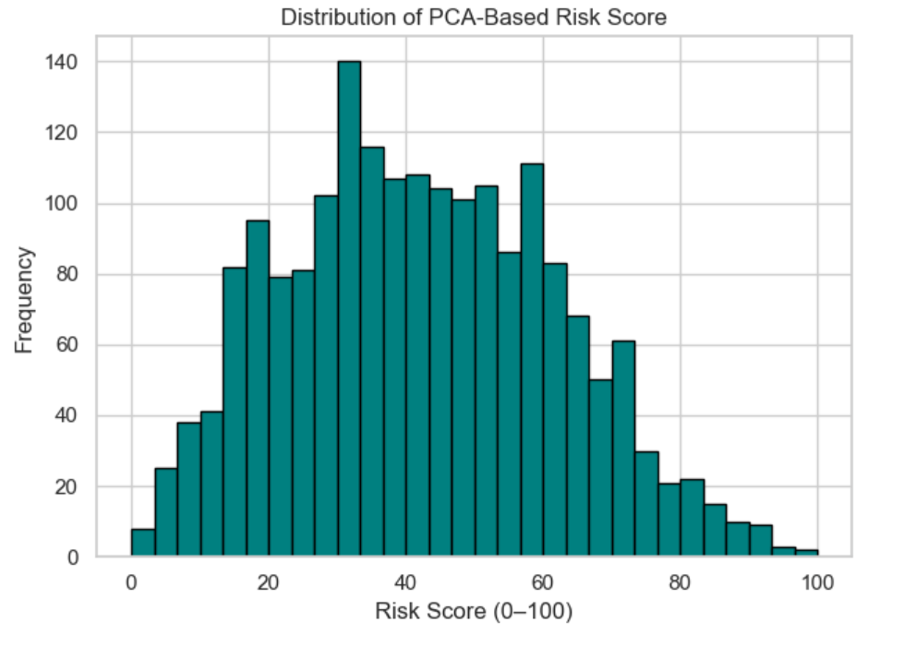
RISK SCORE ENGINEERING
Used PCA to generate a composite fetal distress score
Transformed score to [0, 100] using MinMaxScaler
Result: A continuous risk score replacing categorical labels
This score becomes the target variable for all models.
Fig : Distribution of risk scores

Slide 9
REGRESSION MODELS
Custom implementations :
Standard implementations :
Ridge Regression:
Implemented using matrix operations with L2 regularization and bias term.
Random Forest:
Built from scratch using bootstrapped sampling and an ensemble of decision trees.
XGBoost:
Custom boosting implementation that sequentially adds trees to minimize residuals.
Used scikit-learn for:
Ridge Regression (Ridge)
Random Forest (RandomForestRegressor)
Used xgboost library for:
XGBoost Regressor (XGBRegressor)

Slide 10
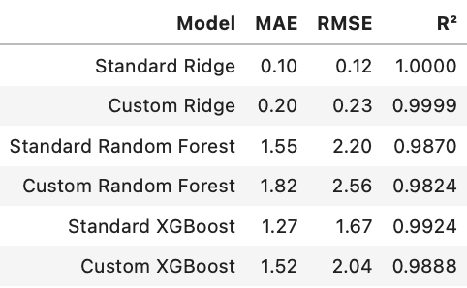
REGRESSION MODELS - EVALUATION
Ridge Regression achieved the highest performance, aligning with the PCA-based linear target.
XGBoost and Random Forest also delivered strong results, handling non-linearities well.
Custom models performed closely to standard ones.

Slide 11
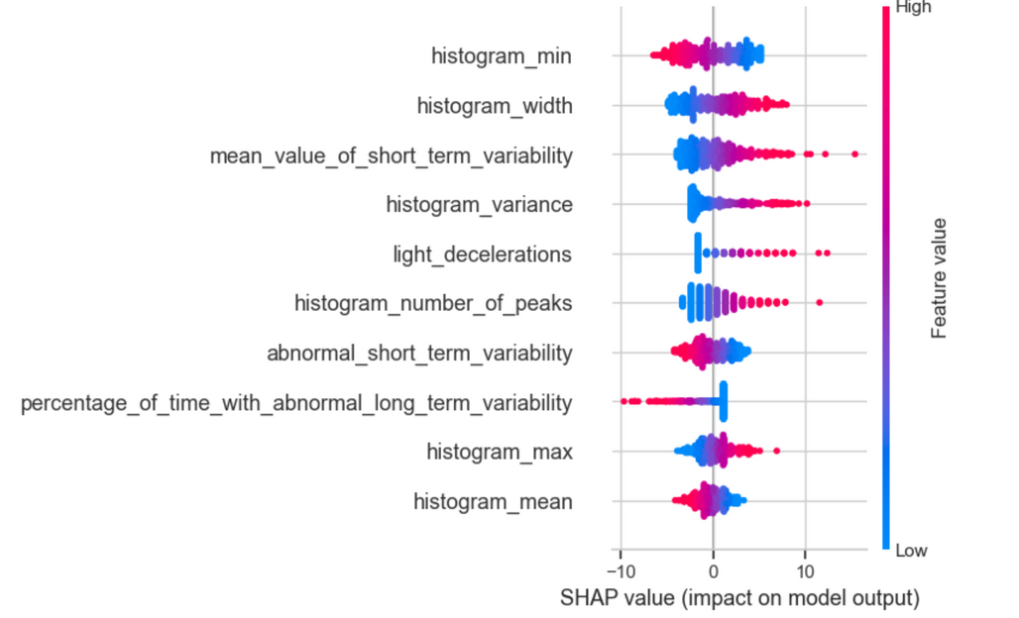
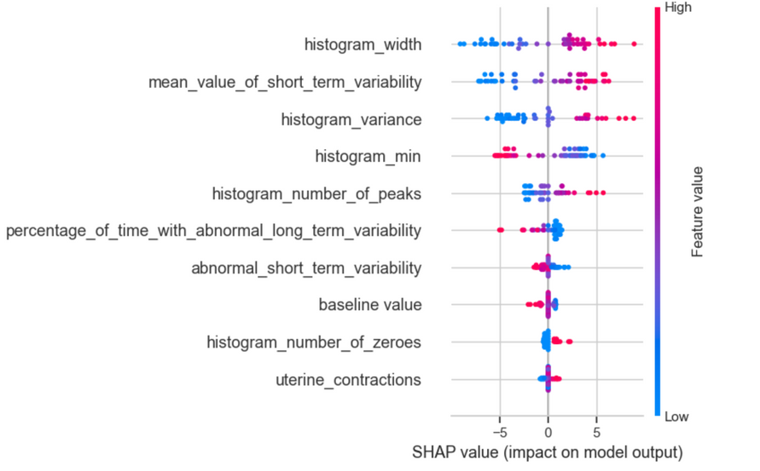
SHAP ANALYSIS
SHAP explains how each feature contributes to the model’s prediction.
Features like histogram_width, histogram_min, and histogram_variance consistently had the most influence on the predicted risk score for all models.
Fig : SHAP For Ridge Regression
Fig : SHAP For XGBoost

Slide 12
CLUSTERING MODELS
Used UMAP to reduce feature dimensions to 2D for better visualization
Enabled visual inspection of how patients were grouped based on fetal risk scores.
Clustering performed using:
K-Means Clustering
Hierarchical (Agglomerative) Clustering
Both in standard (library-based) and custom (from-scratch) forms
Clusters were grouped into: Low Risk, Moderate Risk, and High Risk
Clustering was done both:
On original CTG features
On predicted risk scores from regression models

Slide 13
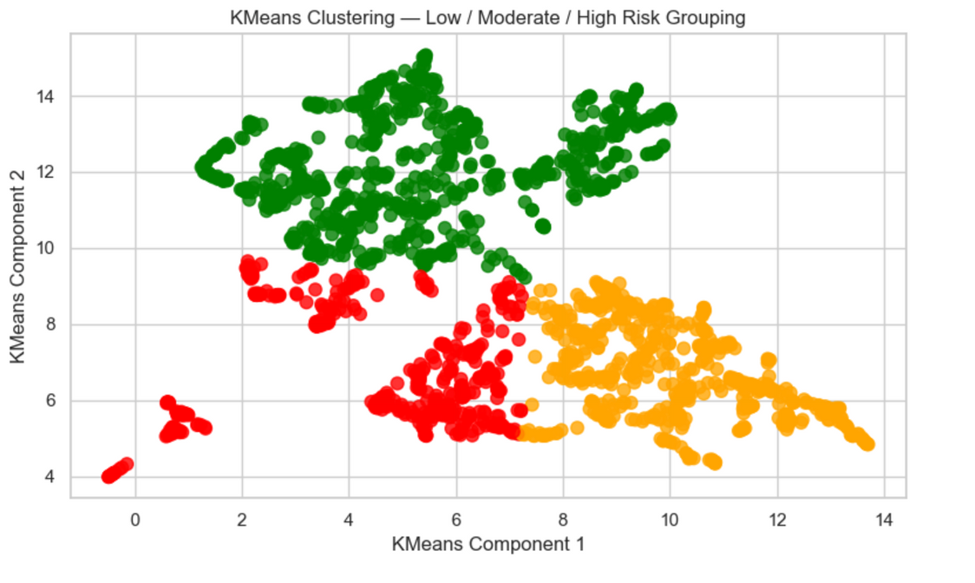
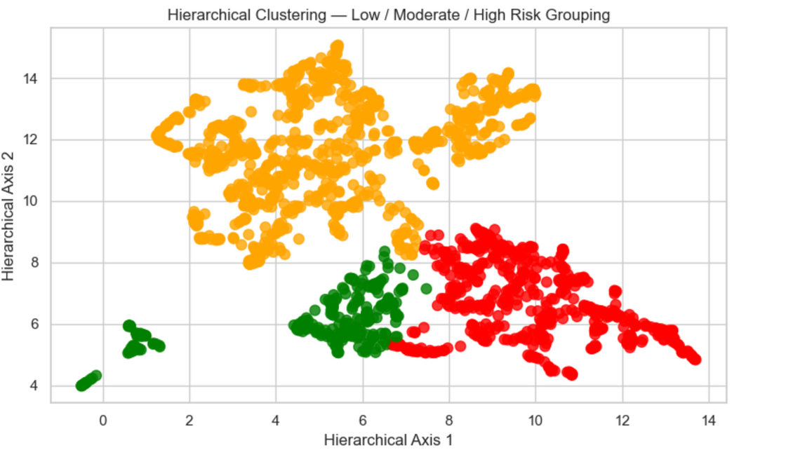

Slide 14
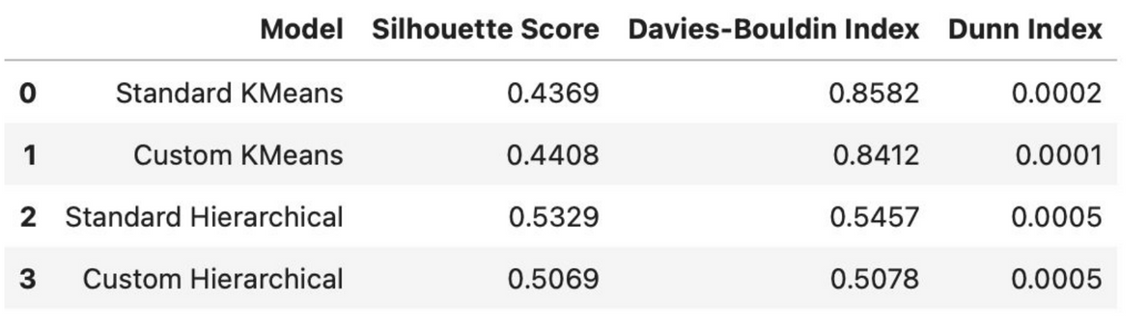
CLUSTERING MODELS - EVALUATION
Standard Hierarchical Clustering achieved the best performance.
Metrics used :
Silhouette Score – Measures how well-separated the clusters are.
Davies-Bouldin Index – Measures average similarity between clusters
Dunn Index – Evaluates compactness and separation.

Slide 15
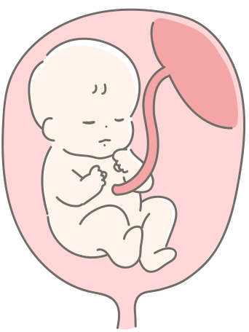
DEMO

Slide 16
CONCLUSION
Regression models were used to predict fetal health risk based on CTG data.
Ridge Regression gave the most accurate results
Important features were identified using SHAP.
Clustering methods clearly separated patients into low, moderate, and high risk.

